Slide 1
Interfacing concept
Interface is the path for communication between two components. Interfacing is of two types, memory interfacing and I/O interfacing.

Slide 2
Memory Interfacing
When we are executing any instruction, we need the microprocessor to access the memory for reading instruction codes and the data stored in the memory. For this, both the memory and the microprocessor requires some signals to read from and write to registers.
The interfacing process includes some key factors to match with the memory requirements and microprocessor signals. The interfacing circuit therefore should be designed in such a way that it matches the memory signal requirements with the signals of the microprocessor.

Slide 3
IO Interfacing
There are various communication devices like the keyboard, mouse, printer, etc. So, we need to interface the keyboard and other devices with the microprocessor by using latches and buffers. This type of interfacing is known as I/O interfacing.

Slide 4
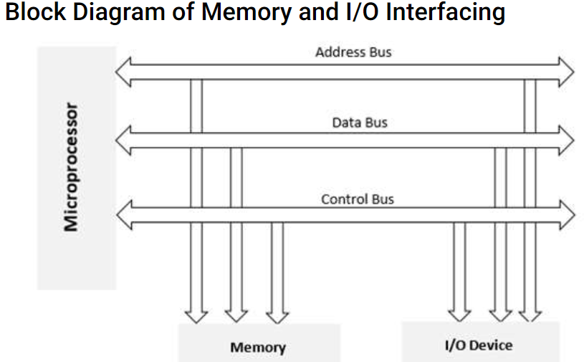
Block Diagram of Memory and I/O Interfacing

Slide 5
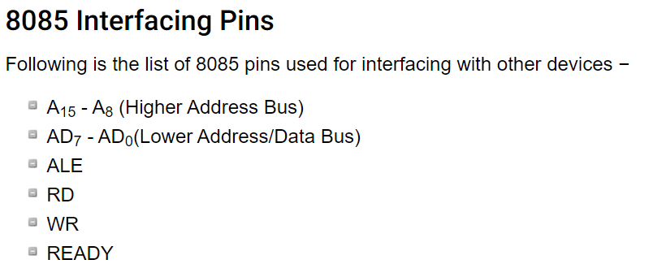
8085 Interfacing Pins

Slide 6
Ways of Communication − Microprocessor with the Outside World?
Serial Communication Interface
Parallel Communication interface

Slide 7
Serial Communication Interface
In this type of communication, the interface gets a single byte of data from the microprocessor and sends it bit by bit to the other system serially and vice-a-versa

Slide 8
Parallel Communication Interface
In this type of communication, the interface gets a byte of data from the microprocessor and sends it bit by bit to the other systems in simultaneous (or) parallel fashion and vice-a-versa.

